Slide 1
Combinational Digital Circuit

Slide 2
Lecture 34 Arithmetic circuits
Lecture delivered by:
Deepak V.

Slide 3
Objectives
At the end of this lecture, student will be able to:
Acquire the knowledge of Binary multipliers
Acquire the knowledge of Ripple adders
Describe BCD Decoder

Slide 4
Topics
Binary Multipliers
Ripple Adders
BCD Decoder
Gray Decoder

Slide 5
Binary Multipliers
Multiplication of binary numbers is performed in the same way as multiplication of decimal numbers
The multiplicand is multiplied by each bit of the multiplier, starting from the least significant bit
Each such multiplication forms a partial product. Successive partial products are shifted one position to the left
The final product is obtained from the sum of the partial products

Slide 6
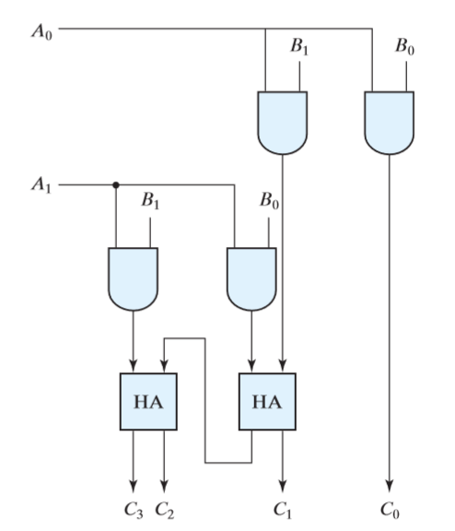
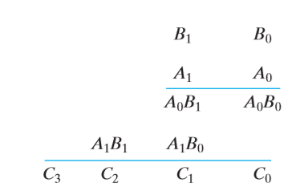
Binary Multipliers
To see how a binary multiplier can be implemented with a combinational circuit, consider the multiplication of two 2-bit numbers
Multiplication of two bit numbers
Two bit multiplier circuit

Slide 7
Binary Multipliers
The multiplicand bits are B1 and B0, the multiplier bits are A1 and A0, and the product is C3 C2 C1 C0
The first partial product is formed by multiplying B1 B0 by A0
The multiplication of two bits such as A0 and B0 produces a 1 if both bits are 1; otherwise, it produces a 0
Therefore, the partial product can be implemented with AND gates as shown in the diagram
The second partial product is formed by multiplying B1B0 by A1 and shifting one position to the left
The two partial products are added with two half-adder (HA) circuits

Slide 8
Binary Multipliers
A combinational circuit binary multiplier with more bits can be constructed in a similar fashion
For J multiplier bits and K multiplicand bits, we need (J * K) AND gates and (J – 1) K- bit adders to produce a product of (J + K) bits
As a second example, consider a multiplier circuit that multiplies a binary number represented by four bits by a number represented by three bits
Let the multiplicand be represented by B3 B2 B1 B0 and the multiplier by A2 A1 A0

Slide 9
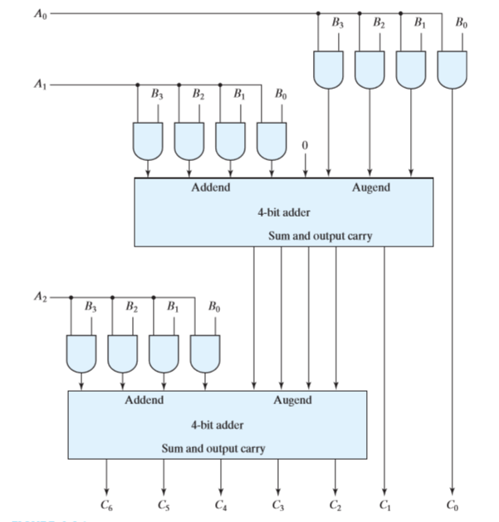
Binary Multipliers
Since K=4 and J=3, we need 12 AND gates and two 4-bit adders to produce a product of seven bits
Four-bit by three-bit
binary multiplier

Slide 10
Ripple carry adder
Multiple full adder circuits can be cascaded in parallel to add an N-bit number
For an N- bit parallel adder, there must be N number of full adder circuits
A ripple carry adder is a logic circuit in which the carry-out of each full adder is the carry in of the succeeding next most significant full adder
In a ripple carry adder the sum and carry out bits of any half adder stage is not valid until the carry in of that stage occurs

Slide 11
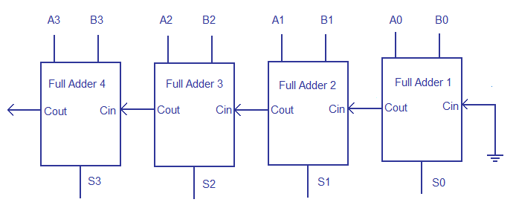
Ripple carry adder
4 bit ripple carry adder

Slide 12
Ripple carry adder
Assume addition of two operands A and B
where ,
A= A3 A2 A1 A0
B=B3 B2 B1 B0
For example: A= 1 0 1 1 +
B= 1 1 0 1
---------------
A+B= 1 1 0 0 0 = C_{out} S₃ S₂ S₁ S₀
From the example above it can be seen that we are adding 3 bits at a time sequentially until all bits are added

Slide 13
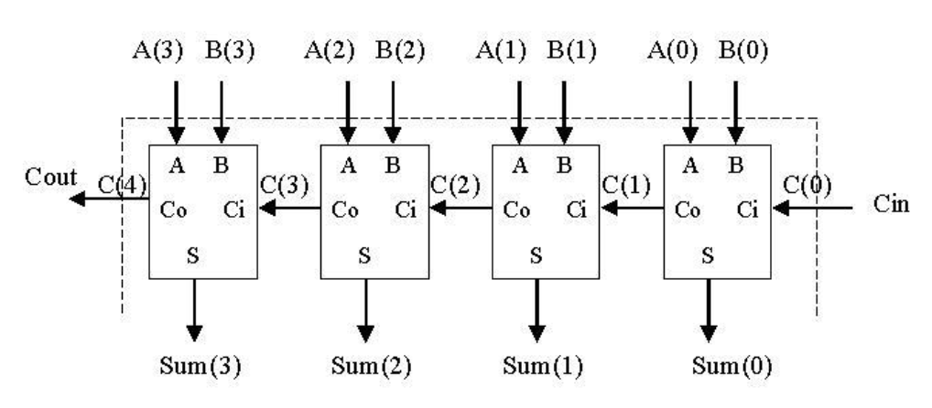
Ripple carry adder
4 Bit ripple adder

Slide 14
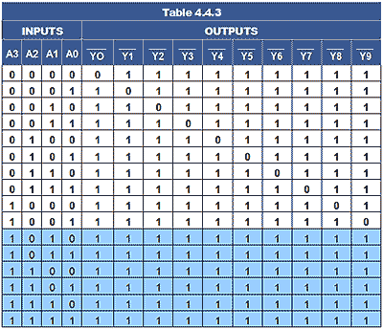
BCD decoder
BCD to decimal decoder
BCD-to-decimal decoder converts each BCD code to its decimal equivalent
Truth table for BCD to decimal decoder

Slide 15
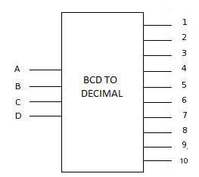
BCD decoder
The technique employed is very similar to the one used in developing the 3-line-to-8-line decoder
Assuming active high outputs are required, Table lists the decoding functions for BCD-to-decimal decoder
BCD to Decimal decoder

Slide 16
BCD decoder
Decoding functions for BCD-to-decimal decoder
DECIMAL DIGIT | BCD INPUTS |  |  |  | LOGIC FUNCTIONS
0 | 0 | 0 | 0 | 0 | A’₃A’₂A’₁A’₀
1 | 0 | 0 | 0 | 1 | A’₃A’₂A’₁A₀
2 | 0 | 0 | 1 | 0 | A’₃A’₂A₁A’₀
3 | 0 | 0 | 1 | 1 | A’₃A’₂A₁A₀
4 | 0 | 1 | 0 | 0 | A’₃A₂A’₁A’₀
5 | 0 | 1 | 0 | 1 | A’₃A₂A’₁A₀
6 | 0 | 1 | 1 | 0 | A’₃A₂A₁A’₀
7 | 0 | 1 | 1 | 1 | A’₃A₂A₁A₀
8 | 1 | 0 | 0 | 0 | A₃A’₂A’₁A’₀
9 | 1 | 0 | 0 | 1 | A₃A’₂A’₁A₀

Slide 17
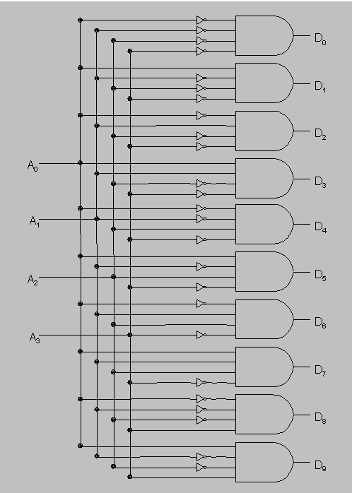
BCD decoder
BCD to decimal decoder

Slide 18
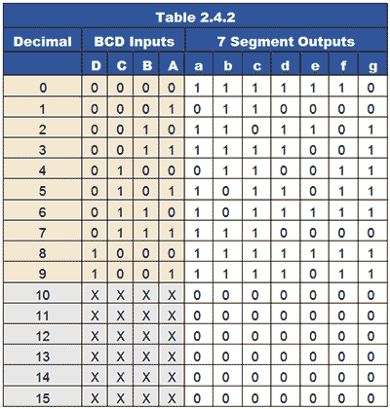
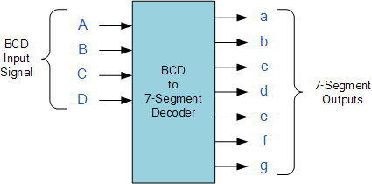
BCD to seven segment decoder
BCD to 7 segment decoder Block diagram
BCD to 7 segment decoder truth table

Slide 19
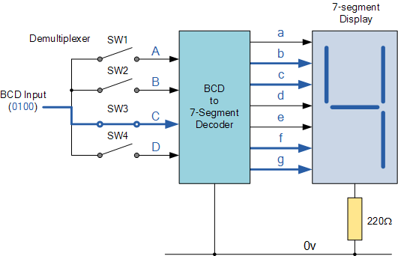
BCD to seven segment decoder
BCD to 7 Segment block diagram

Slide 20
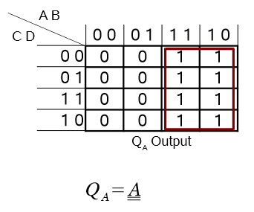
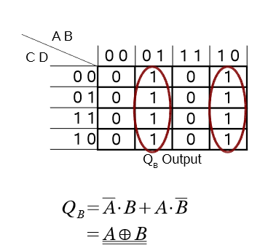
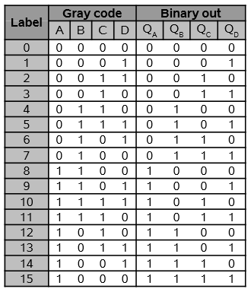
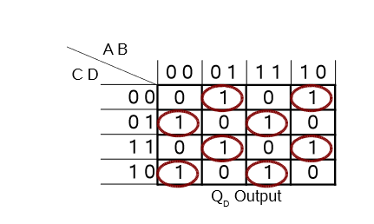
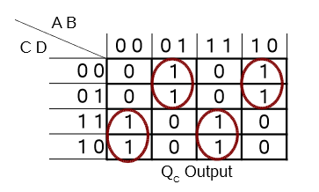



Gray decoder
Gray to binary decoder
Gray to binary truth table
Gray to binary K-map

Slide 21
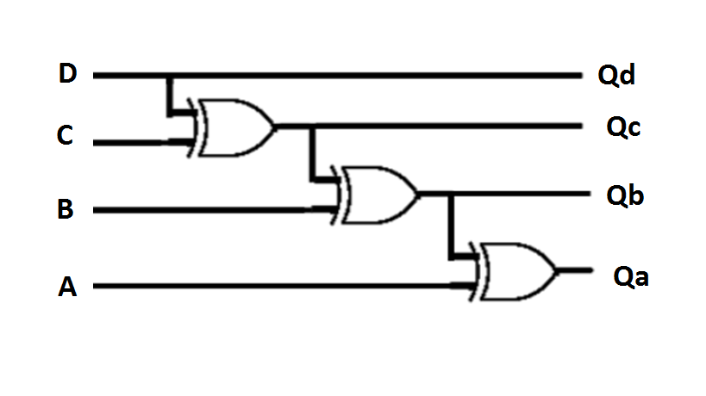
Gray to binary decoder
Gray to binary decoder

Slide 22
Summary
For J multiplier bits and K multiplicand bits, we need (J * K) AND gates and (J – 1) K- bit adders to produce a product of (J + K) bits
A ripple carry adder is a logic circuit in which the carry-out of each full adder is the carry in of the succeeding next most significant full adder
A BCD to decimal decoder can be realized using a 4:16 decoder or by using logic circuits
A BCD to seven segment decoder is used to drive a seven segment display
A gray to binary decoder can be realized by finding out the Boolean expression using K-map

